Slide 1
Control Unit
CPU generates control signals to execute instruction.
Two ways to implement control circuitry.
  Hardwired Control
  Microprogrammed Control

Slide 2
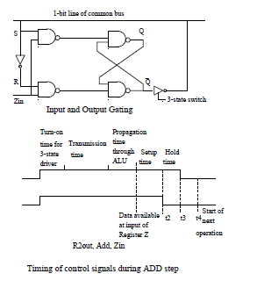
Register Gating

Slide 3
Hardwired Control
Separate circuit for generating each control signal.
Control signals needed for execution of instruction depend on:
  Step number
  Contents of instruction register
  Contents of condition code and other status flag.

Slide 4
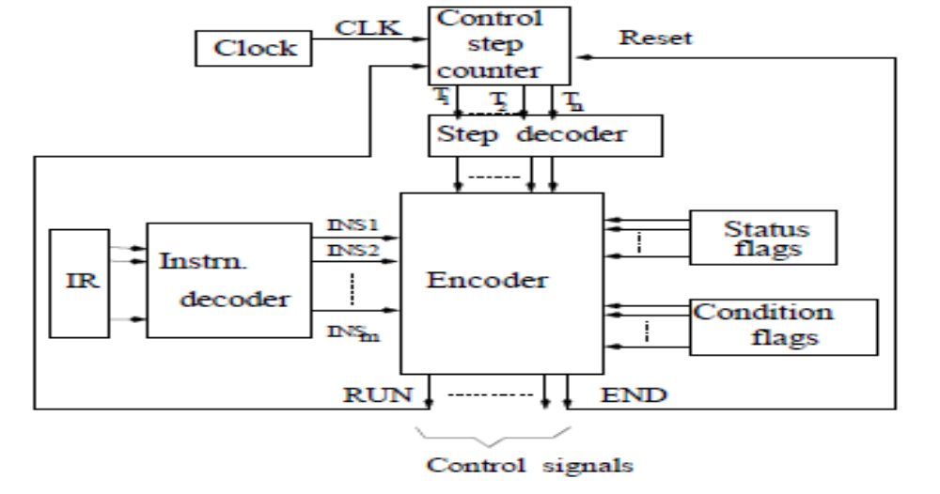
Hardwired Control
Hardware required for generation of control signals.

Slide 5
Step-counter
Value of counter indicates step to be executed in sequence of steps for instruction.
Counter should be reset at the end of an instruction.
Step-decoder: Sets one of the lines (T1 to Tn) to 1.
Clock : Step counter is incremented at every CLK pulse.
  Period of clock be large enough for execution of each step.
Instruction-Decoder: Sets one of lines from INS₁ to INS_{m} to logic 1 indicating the instruction.
Encoder : Combines input signals from step decoder and instruction-decoder to generate output signals to control various gates and ALU.

Slide 6
Control Signals needed for ADD R1, [R2]
As discussed in earlier lecture, signals needed in each Step are as
1. PC out, MAR in, Read, Clear Y, Set Carry­_in to ALU, Add, Z in
  2. Z out, PC in, WMFC
  3.MDR out, IR in
  4.R2 out, MAR in, Read
  5.R1 out, Y in, WMFC
  6. MDR out, Add, Z in
  7.Z out, R1 in
  Add: T1, T6;MAR_in: T1,T4; Z_out: T2,T7;MDR_out:T3,T6;
  Zin: T1,T6;WMFC:T2,T5; Read: T1,T4;PC_out:T1; …….

Slide 7
Example of an encoder
Let us assume that for a given processor the following conditions are true.
  For a unconditional branch instruction (BR), Z in signal has to be generated in step 5 (T5).
  For ADD instruction, Z in signal has to be generated in step 6 (T6).
  For all instructions, Z in signal has to be generated in step 1 (T1).
  We can combine all the cases, where the Z in signal has to be set to 1, and can design a combinational circuit implementing the logic function

Slide 8
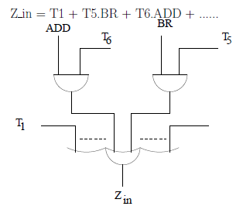
Example of an encoder

Slide 9
Example of an encoder
End signal should be generated in step 7 (T7) of ADD instruction, step 4 of conditional branch BRN (branch on negative) if the condition is not satisfied, and in step 6 of unconditional branch BR and conditional branch (branch on negative) if condition is satisfied.
End = ADD.T7 + BRN.not(N).T4+ (BR + N.BRN) T6 + ....

Slide 10
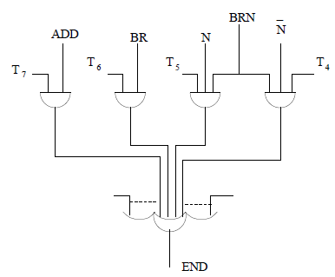
Example of an encoder

Slide 11
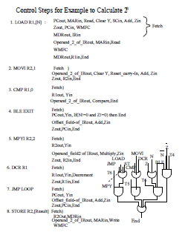
An Example

Slide 12
CPU-Memory Interaction
Step counter increments under following conditions:
  No read or write request is generated by CPU and CPU is not waiting for any memory function to complete.
  The memory function for which the CPU is waiting is completed.

Slide 13
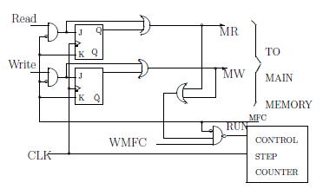

Slide 14
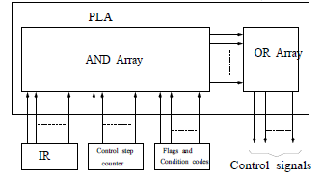
Implementation of sequence controller
One possible implementation is by using Programmable Logic Array (PLA)

Slide 15
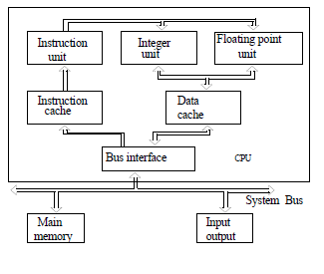
Complete CPU

Slide 16
Microprogrammed Control
Control signals generated by memory storage within the processor.
The address to the memory is composed of time step signals, the contents of instruction register and flags.
Contents of the memory provides control signals, and are called Control Word.
A control word for an instruction is also called micro-instruction.

Slide 17
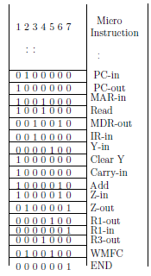
Example
Microinstructions for Add R1, [R3].

Slide 18
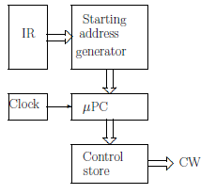
Microprogrammed Control Unit
Machine instruction corresponds to fixed sequence of microinstructions.
  Control store has the microprogram.
  Control unit generates control signals for an instruction from control store.

Slide 19
Formatting of microinstructions
Horizontal Microprogramming: Each control signal need one bit position in microinstruction.
Length of a microinstruction or control word is very large
Very few of these control signals will have a value 1.
Vertical Microprogramming: Form groups of signals which are mutually exclusive
Example: only one register can have its output enabled to transfer data to CPU bus.
By this coding the microinstruction size can be reduced.
Overhead with vertical microprogramming is hardware cost and time penalty for decoding.

Slide 20
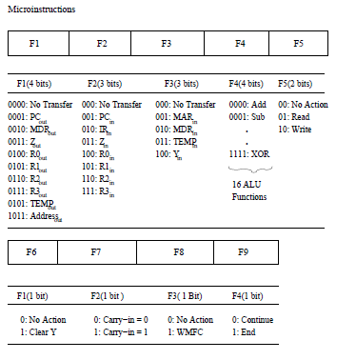
Field encoded microinstruction

Slide 21
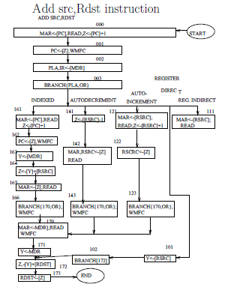
Flowchart for a microprogram

Slide 22
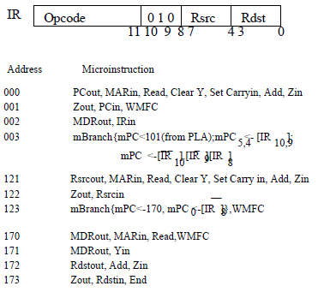
Microroutine for Add (Rsrc)+,Rdst.

Slide 23
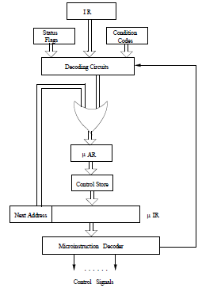
Microinstruction sequencing organization

Slide 24
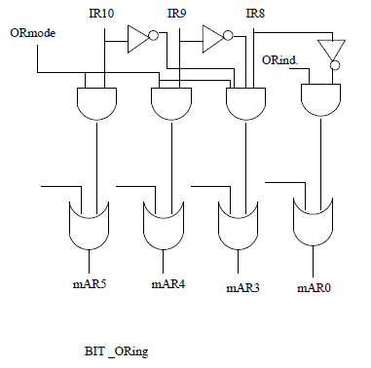
Control circuitry for bit-ORing

Slide 25
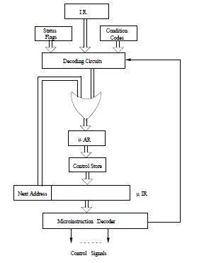
Microinstruction sequencing organization

